Slide 1

Data Presentation
Peleg Abraham-Oz

Slide 2

Order of presentation
About the experience
Data
Questions
How I worked
Results

Slide 3
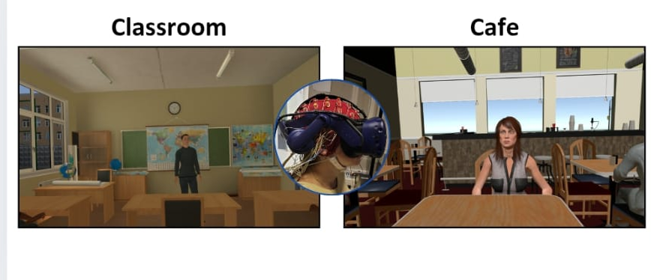
Experience Overview
65 subjects X 2- week between sessions
EEG , GSR, Eye movement, Performance & Subjective Ratings -> Behavior data
Accuracy & Interest level

Slide 4
The experience- 2X3X2
Environment
Classroom
Cafe
M
R
M
R
IR
IR
ADHD
Control

Slide 5
General information
Subjects total: 65X 2
Two environment: Classroom & Café
Subject data : 61
Subject that not included: 4 (one session)

Slide 6
Questions
Does environment affect?
Attention:
Mix- Dual task
Relevant- easy dual task
IRrelevant- single task
3. ADHD vs CONTROL

Slide 7
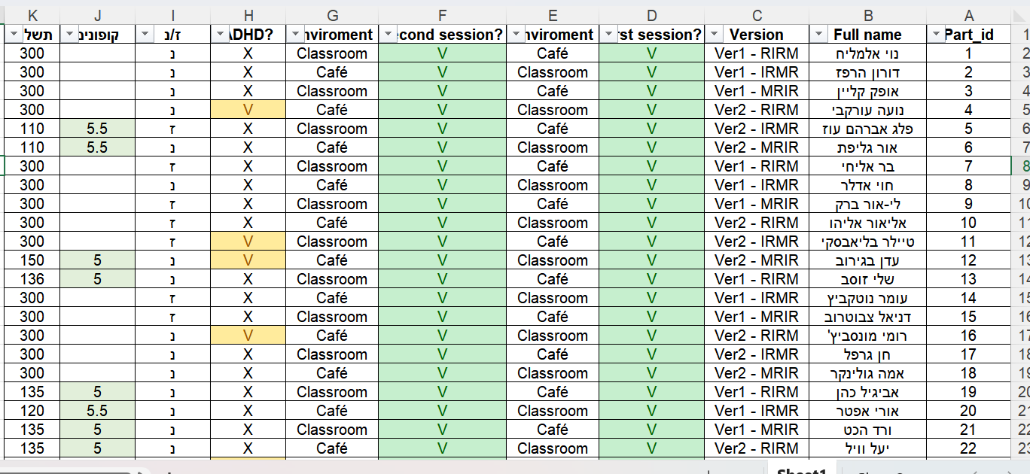
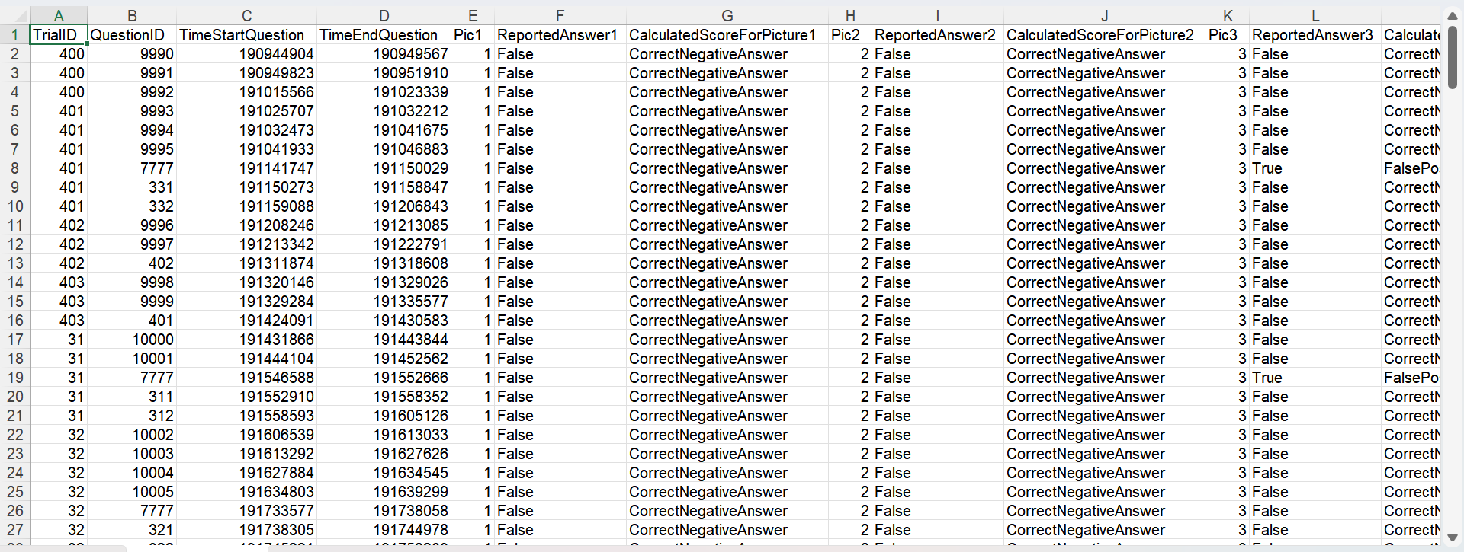
Data
Information file
All files
122 files

Slide 8
planning
Extend the relevant data
“separate ways”- accuracy, Interest level
Assembling to one sheet
visualization

Slide 9
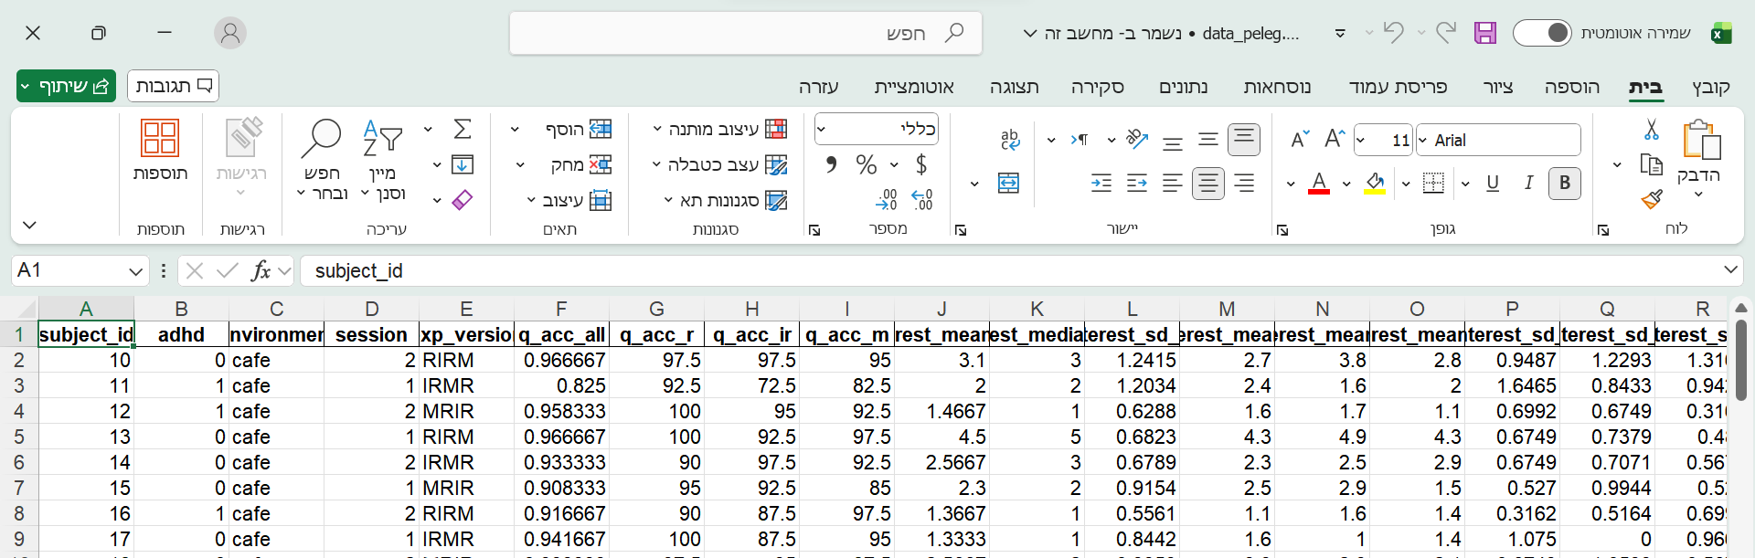

Slide 10
Code phase

Slide 11
accuracy

Slide 12
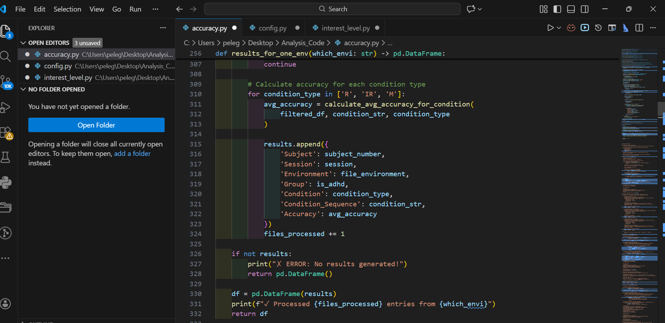

Slide 13
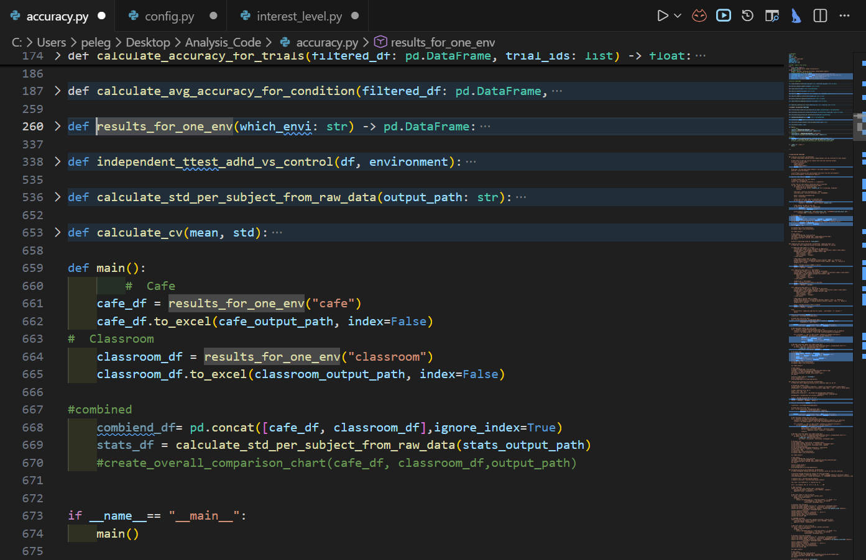

Slide 14
Interest Level

Slide 15
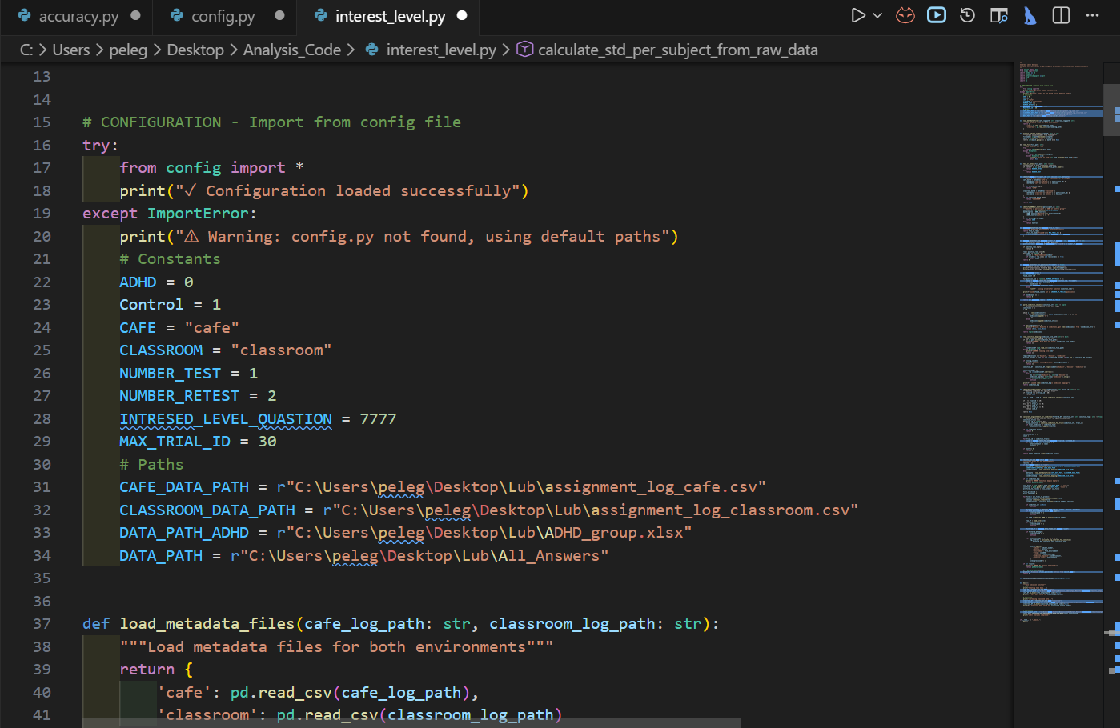

Slide 16
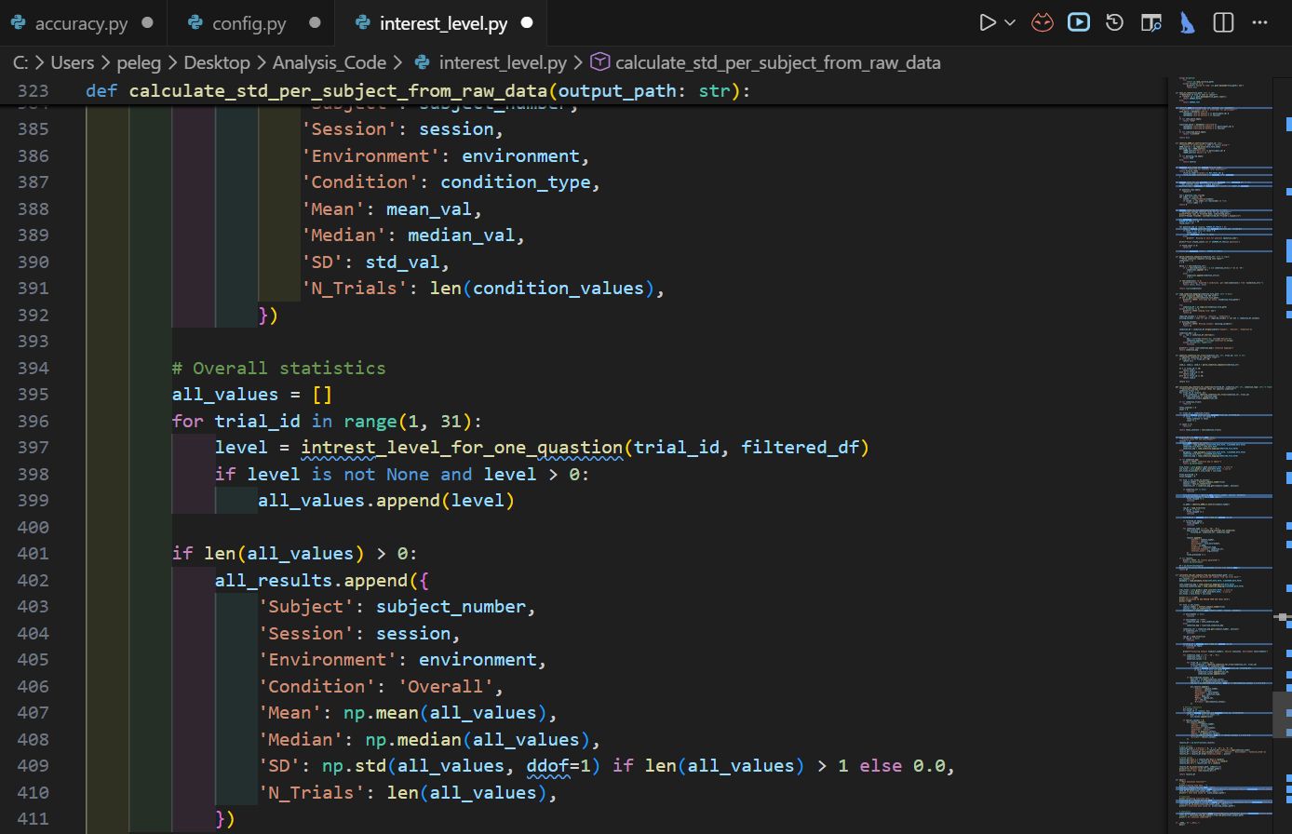

Slide 17
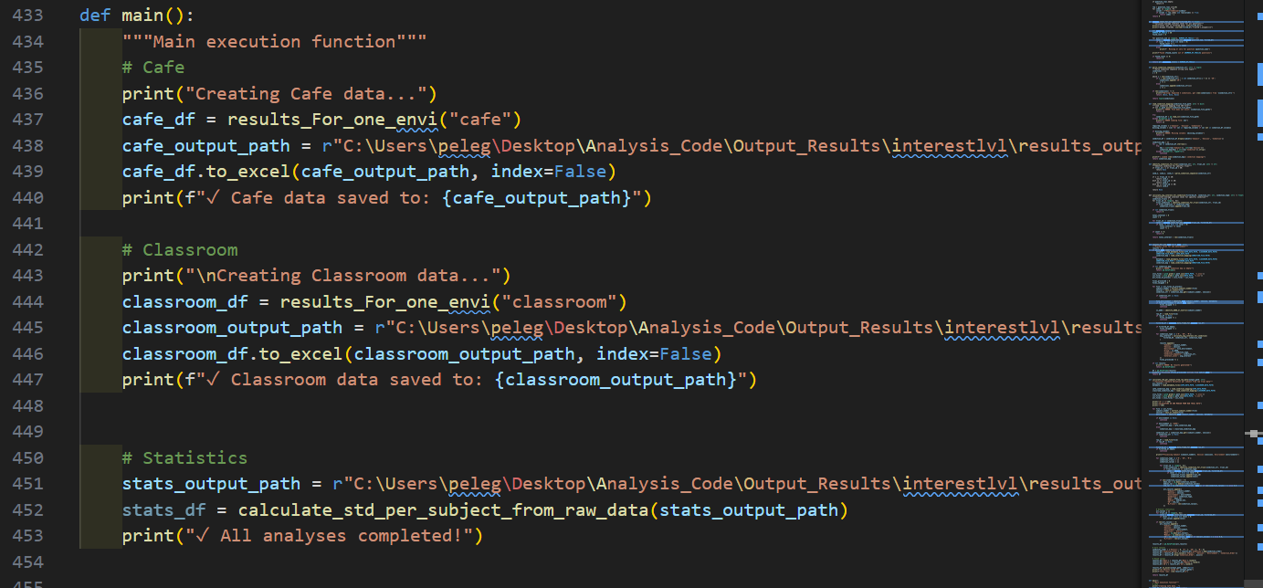

Slide 18
Gathering data

Slide 19
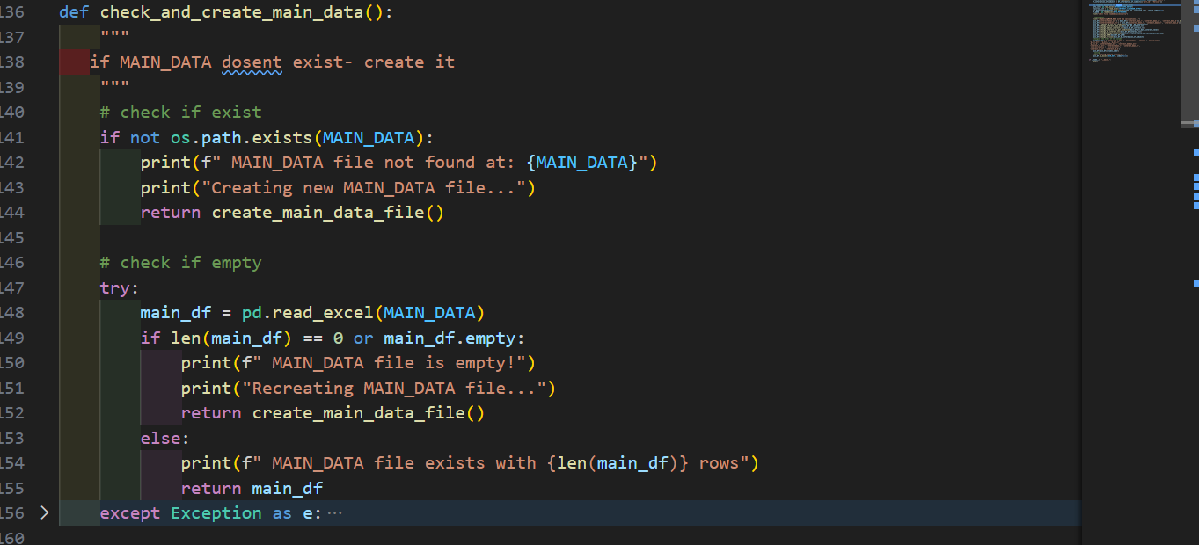

Slide 20
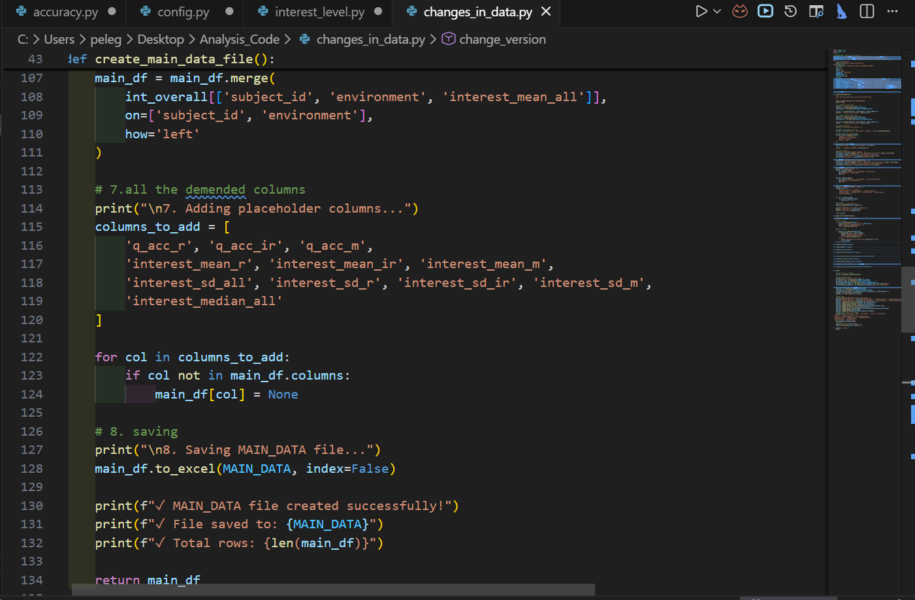

Slide 21
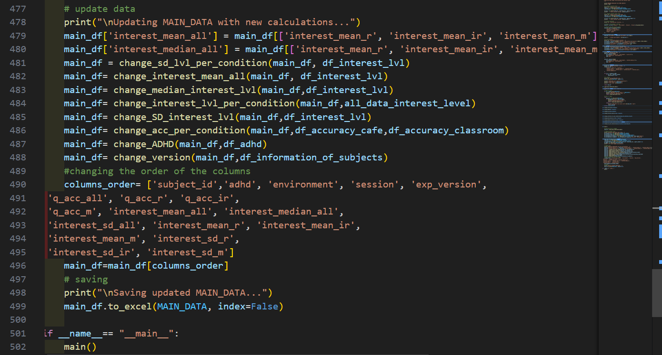

Slide 22
Classroom-Accuracy

Slide 23
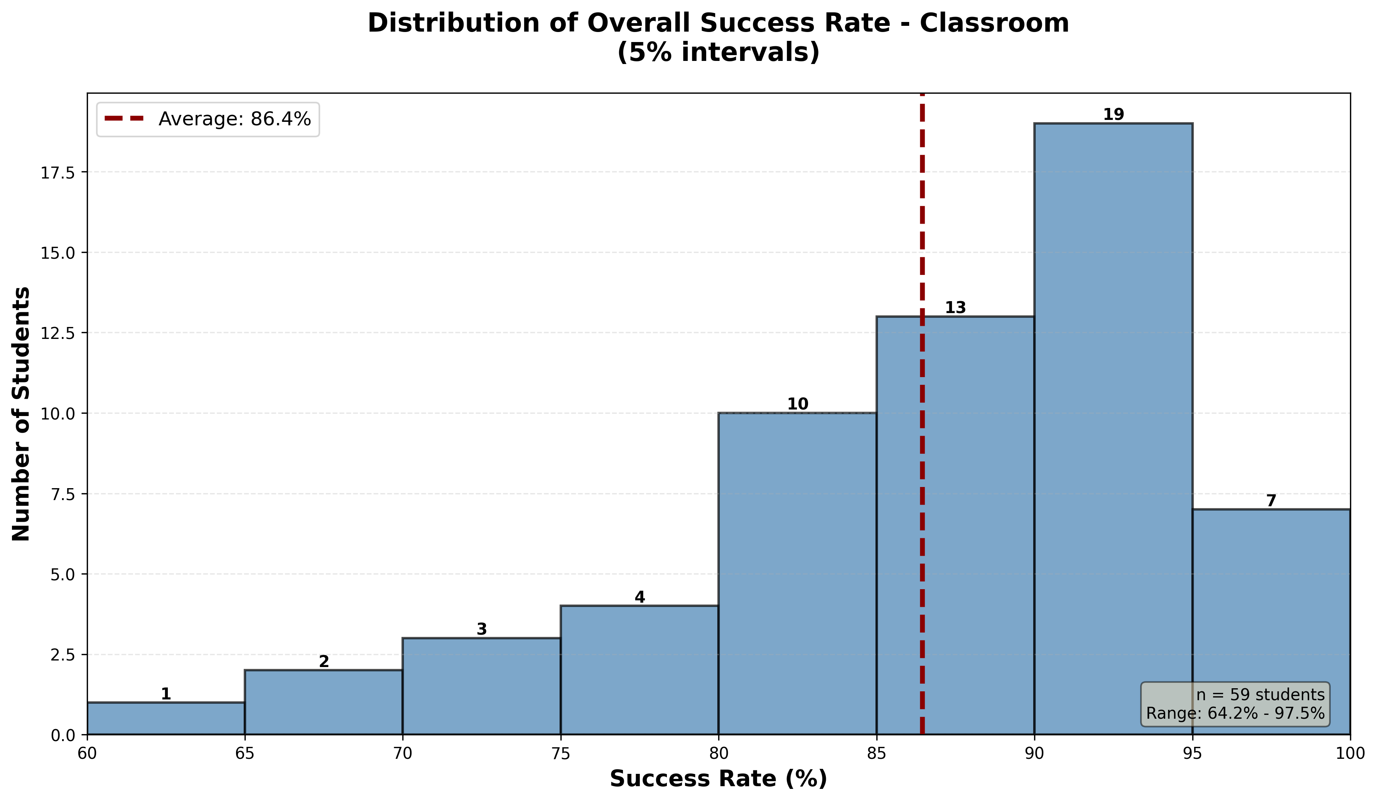


Slide 24
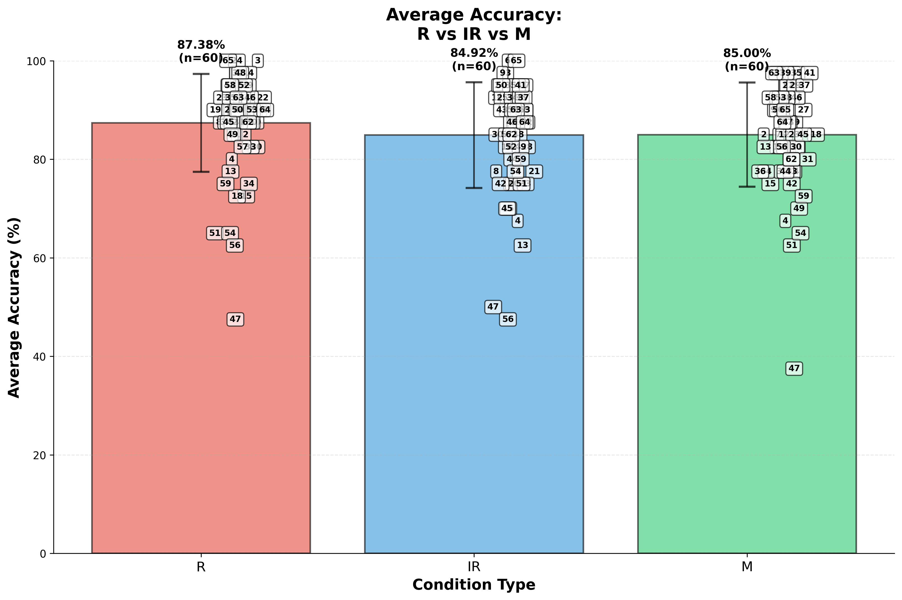

Slide 25
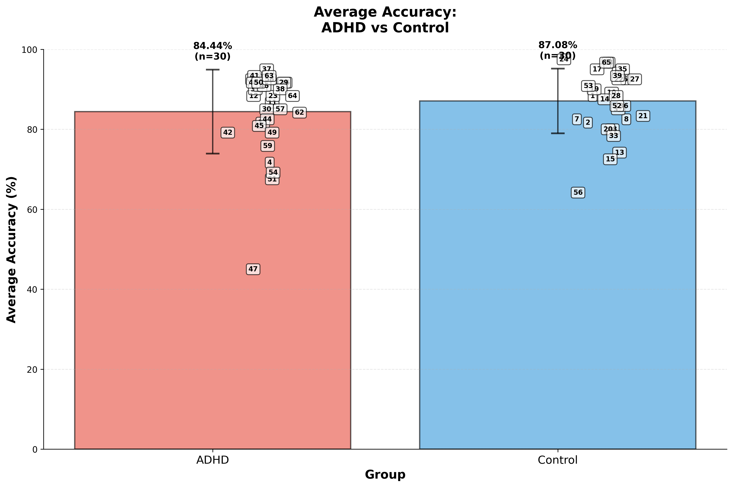

Slide 26
T-test independent- ADHD , Control
T-test results
t-statistic | -1.0912
p-value | 0.279
Degrees of Freedom (df) | 58
Effect size(Cohen's d)
Cohen's d Value | -0.281

Slide 27
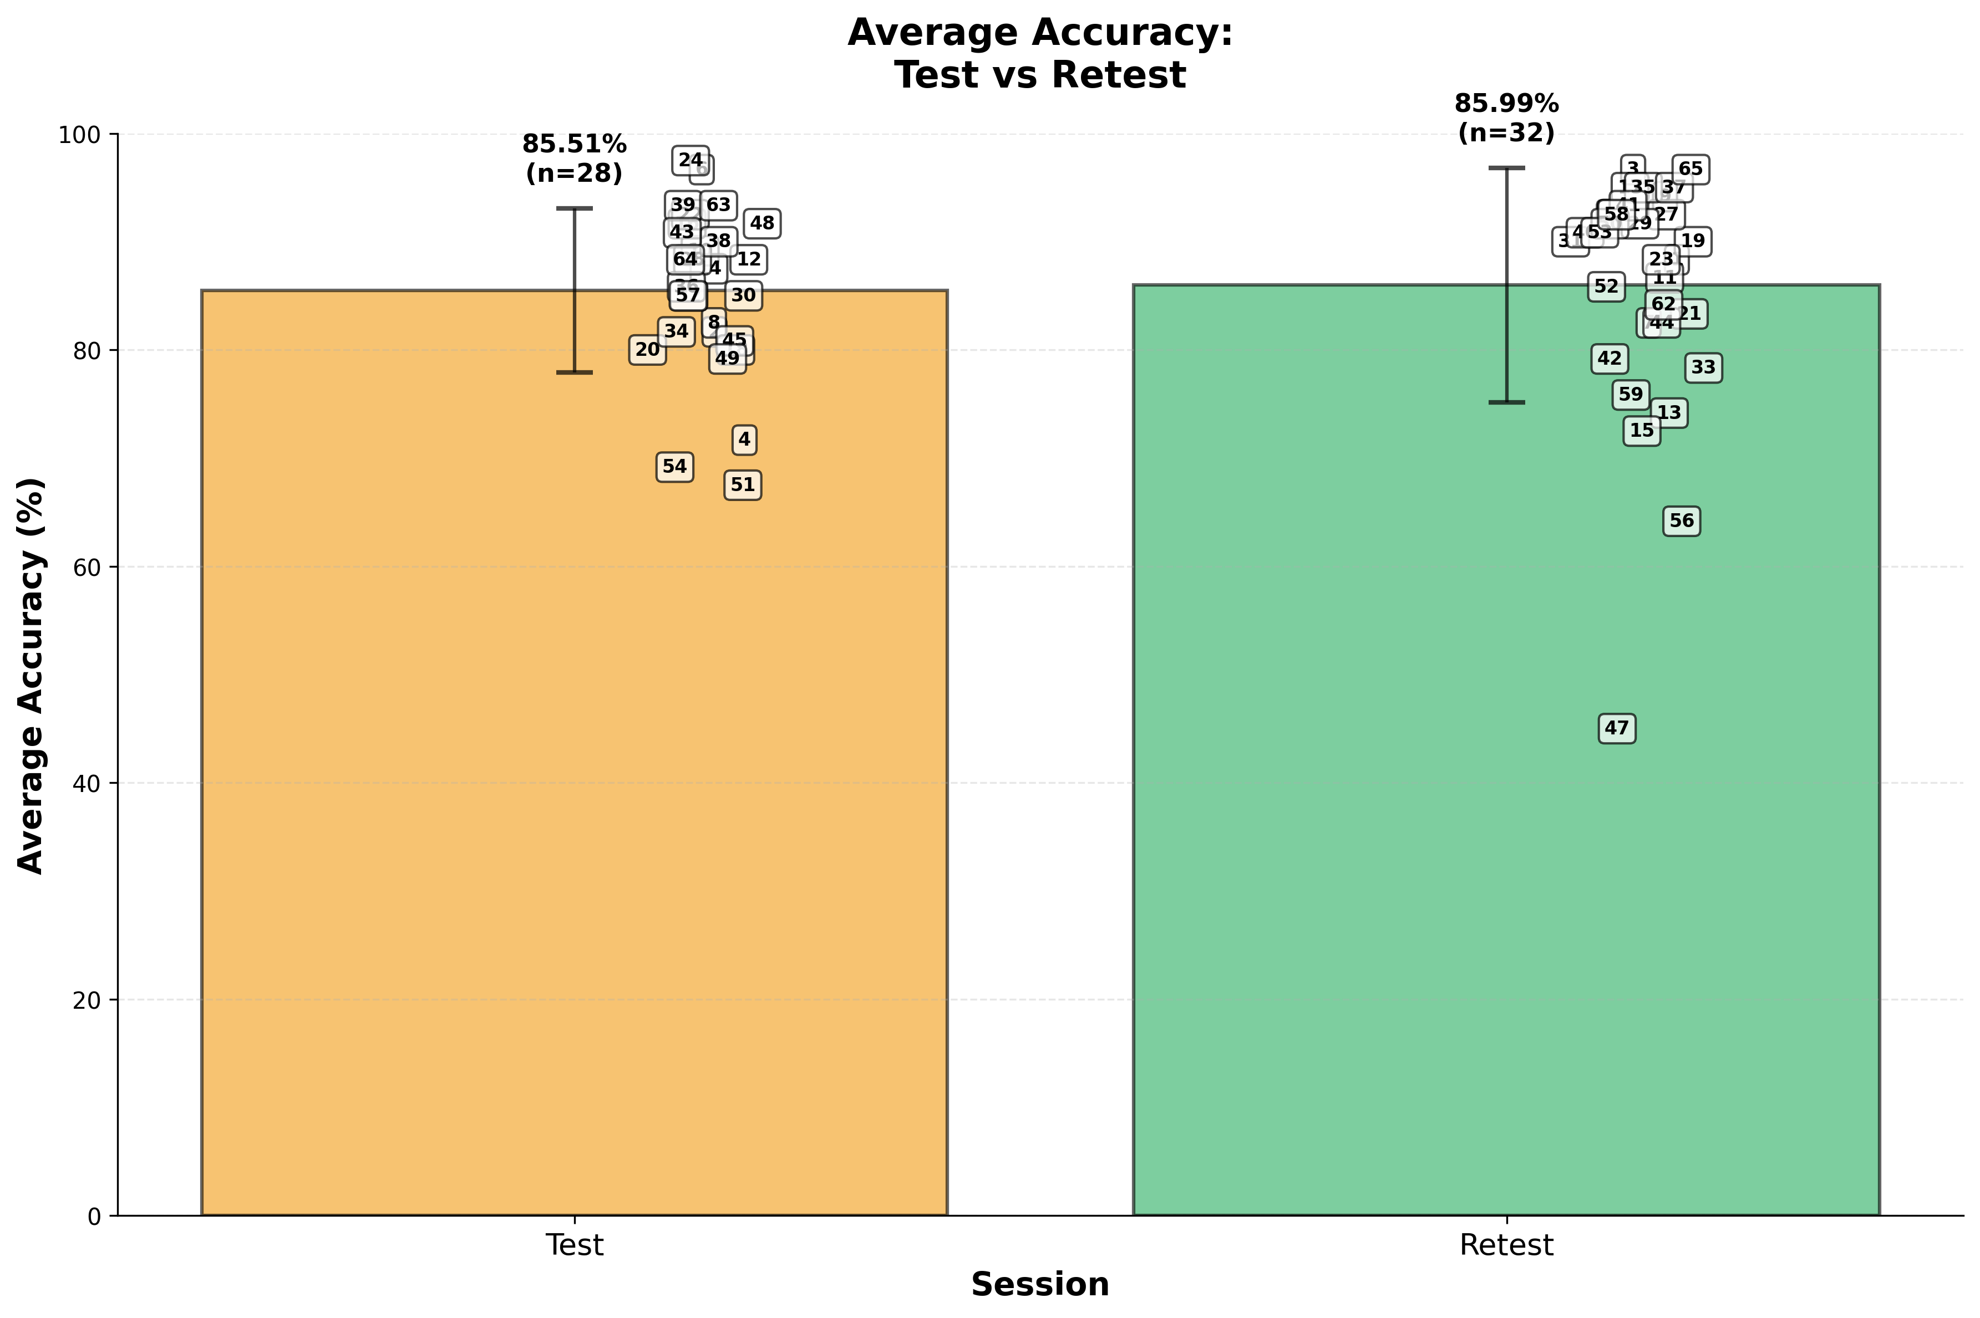

Slide 28
Cafe

Slide 29
Café
-Interest level

Slide 30
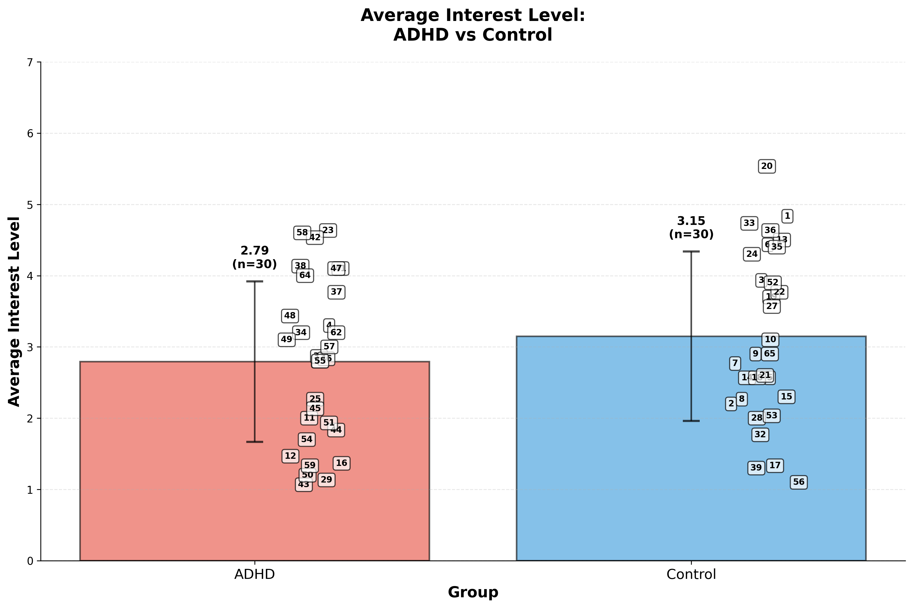

Slide 31
T-test independent- ADHD , Control
T-test results
t-statistic | -1.1886
p-value | 0.2394
Degrees of Freedom (df) | 58
Effect size(Cohen's d)
Cohen's d Value | -0.3069

Slide 32
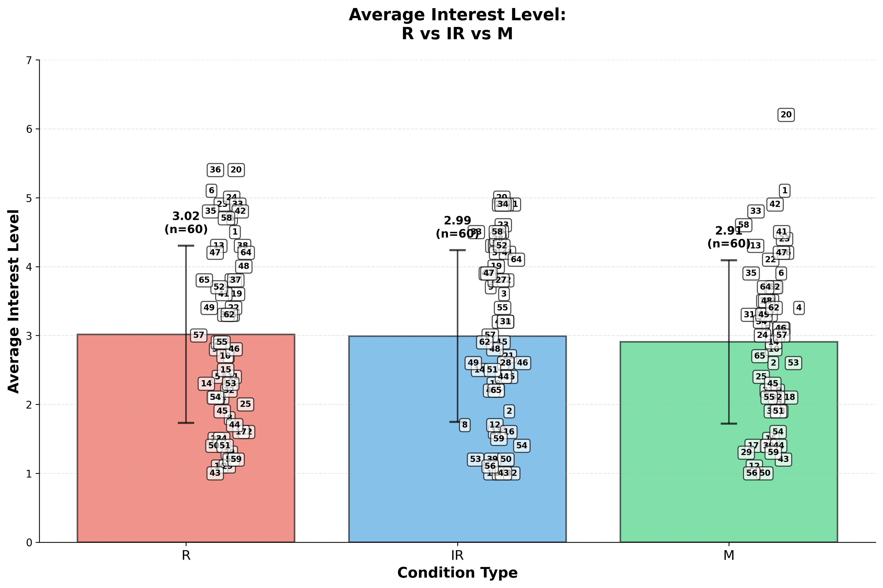

Slide 33
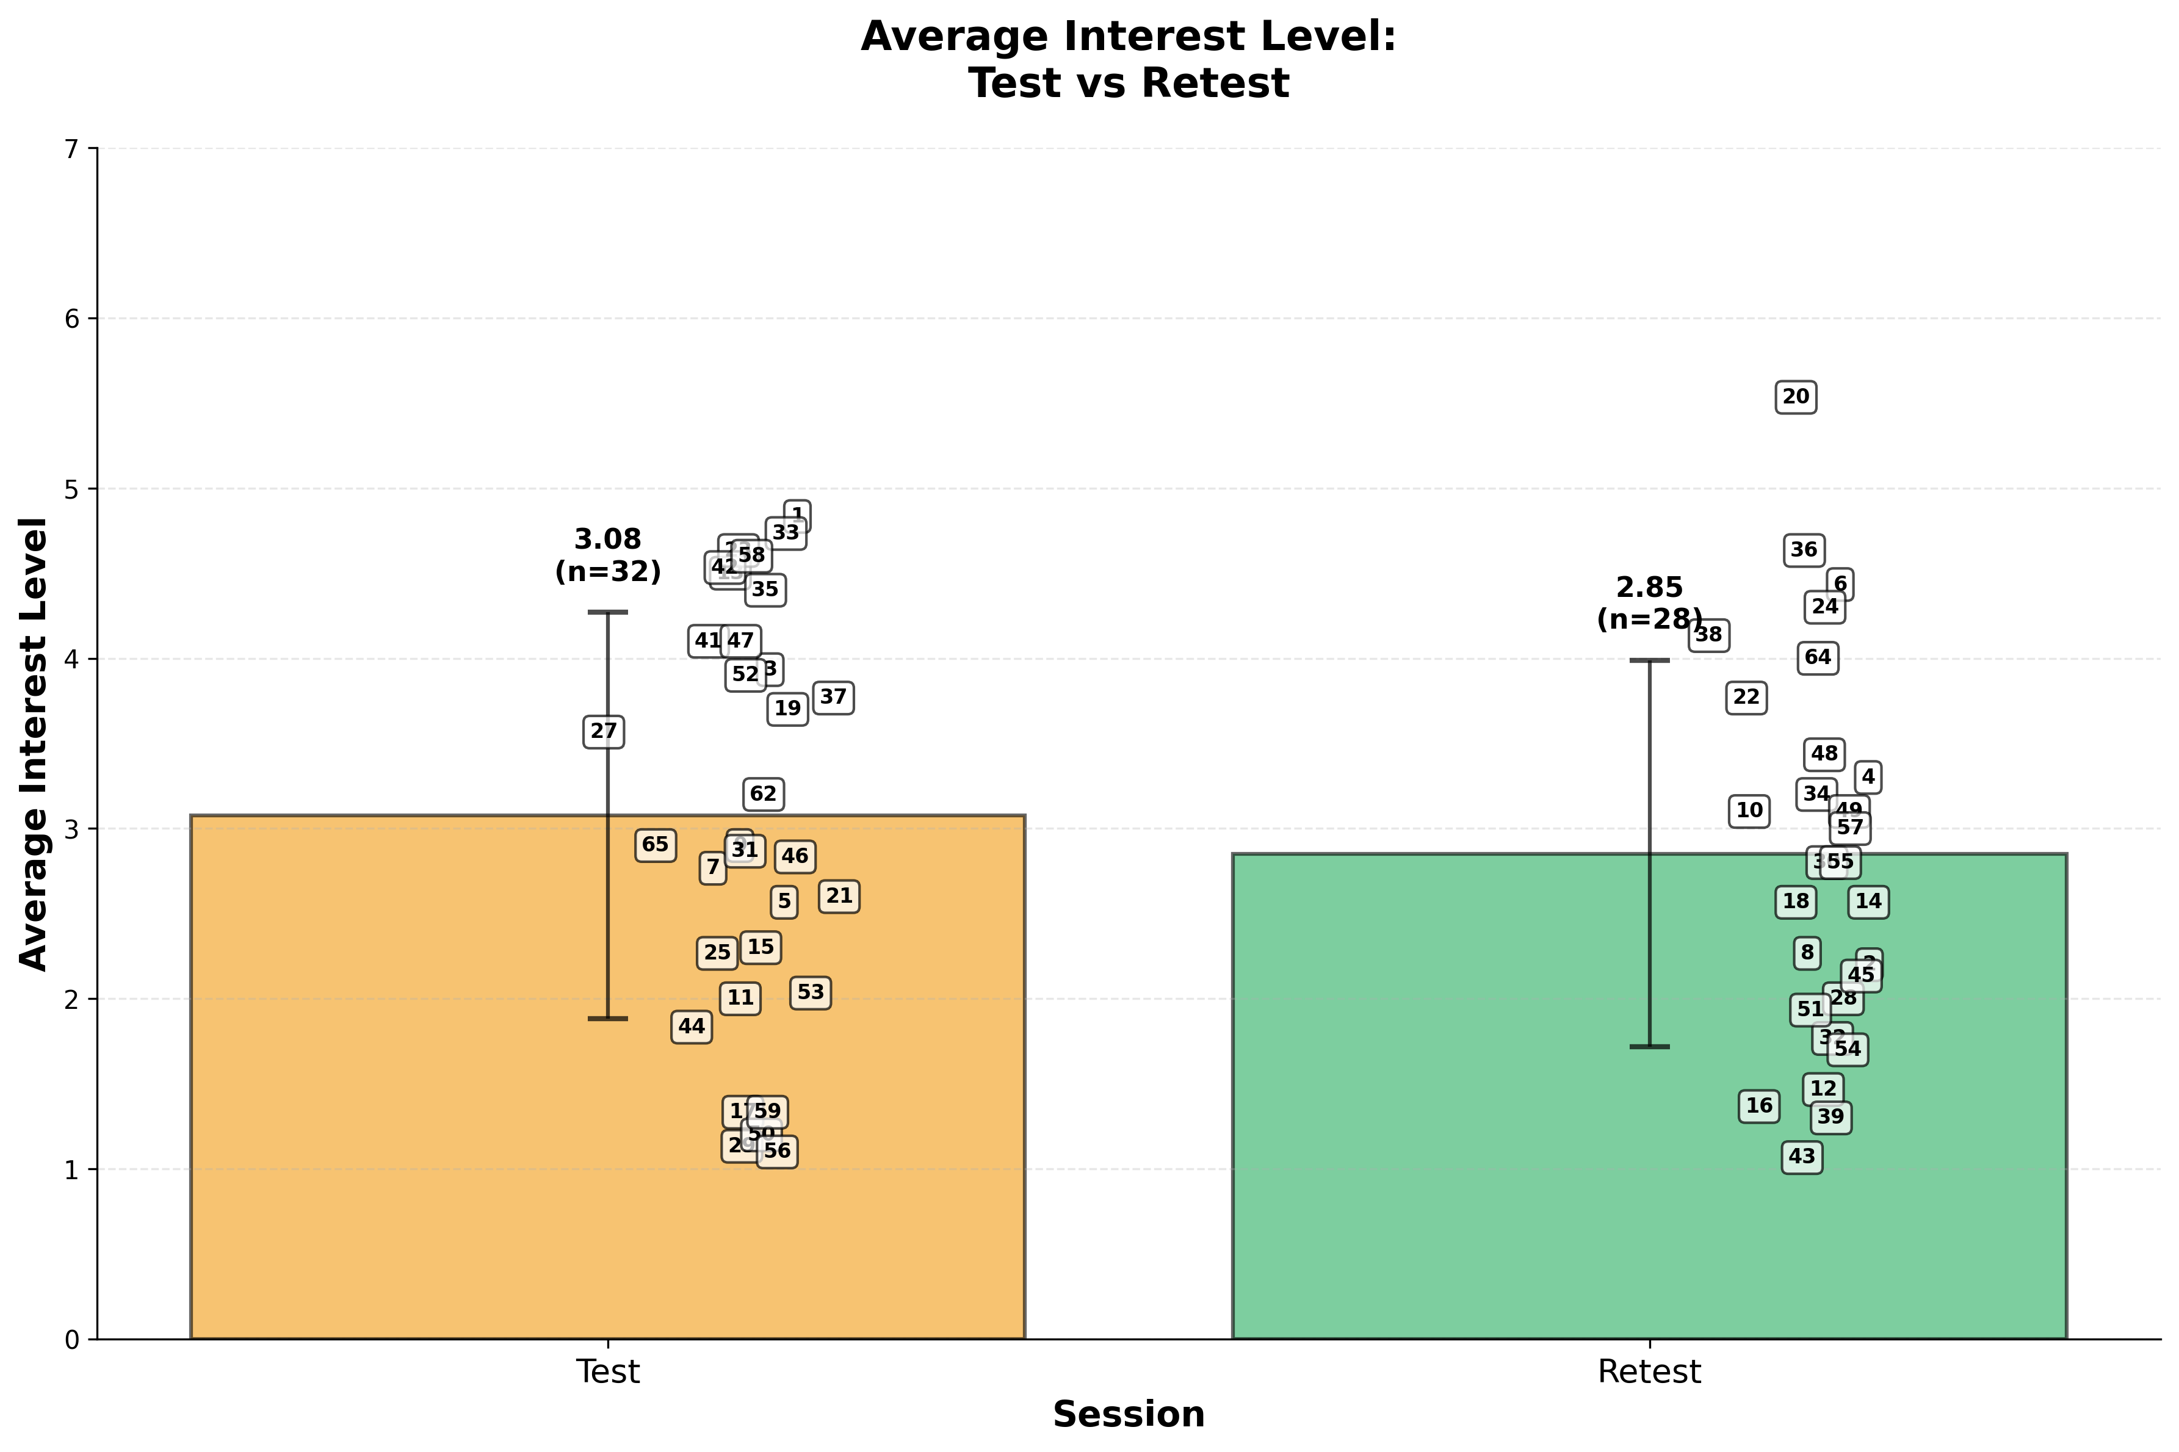

Slide 34

Cafe environment
Compare environments
מידע על הסביבה

Slide 35
Cafe environment
Accuracy [%]
מידע על הסביבה
category | Percentage
Mean different | 6.55%
Standard Deviation (SD) | 2.35%
Variance | 157.09%

Slide 36
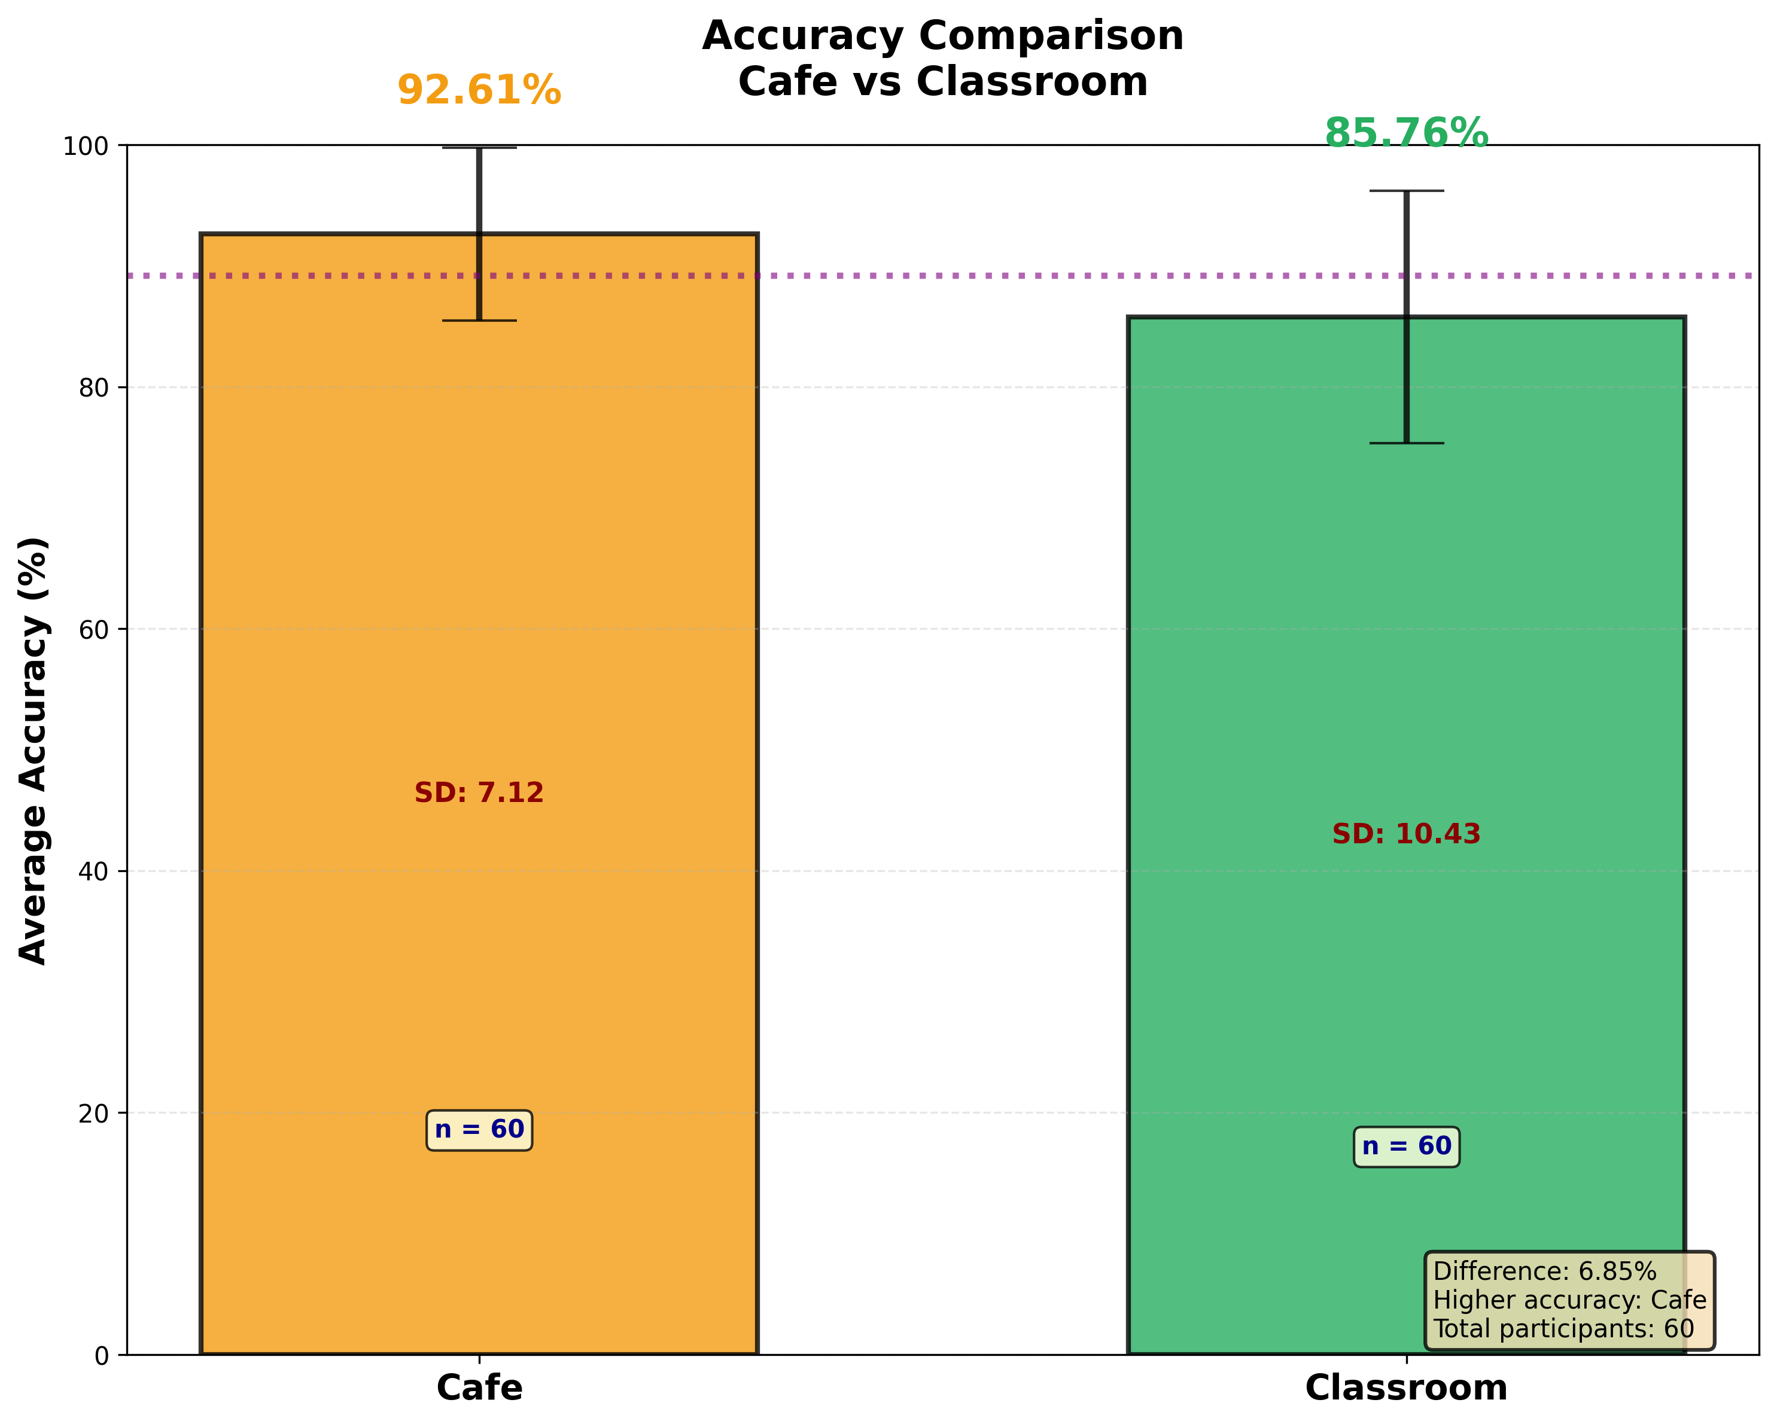

Slide 37
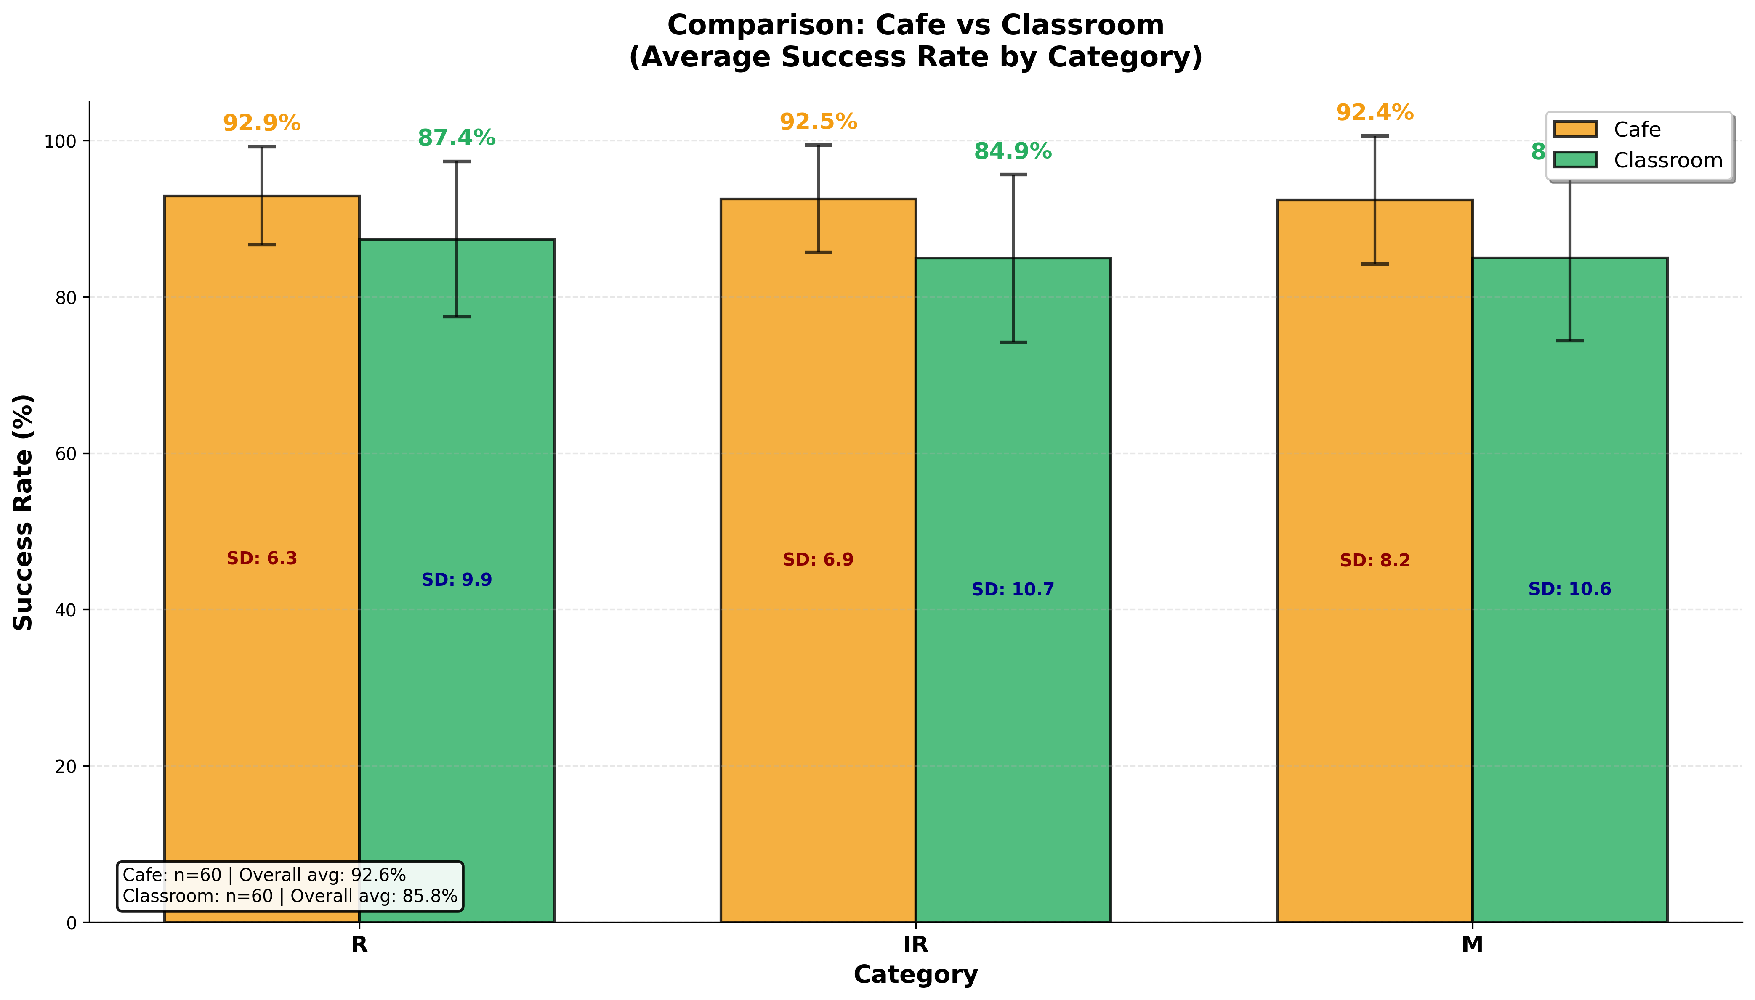

Slide 38
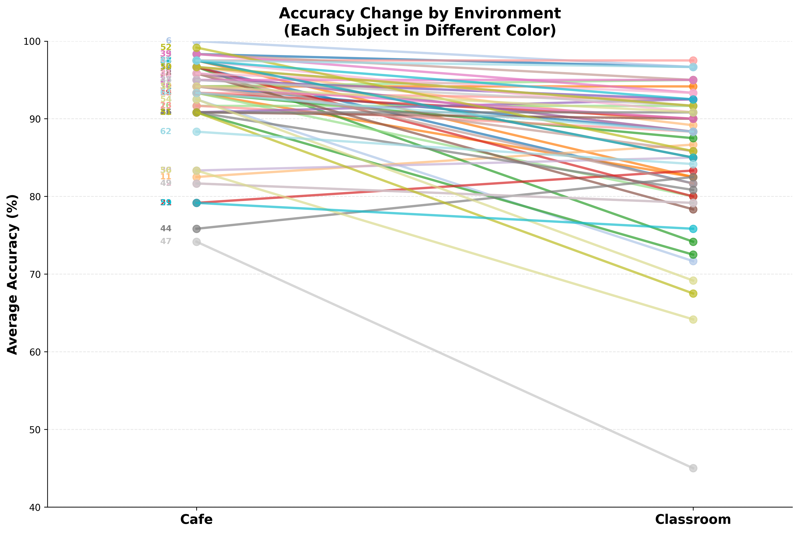

Slide 39
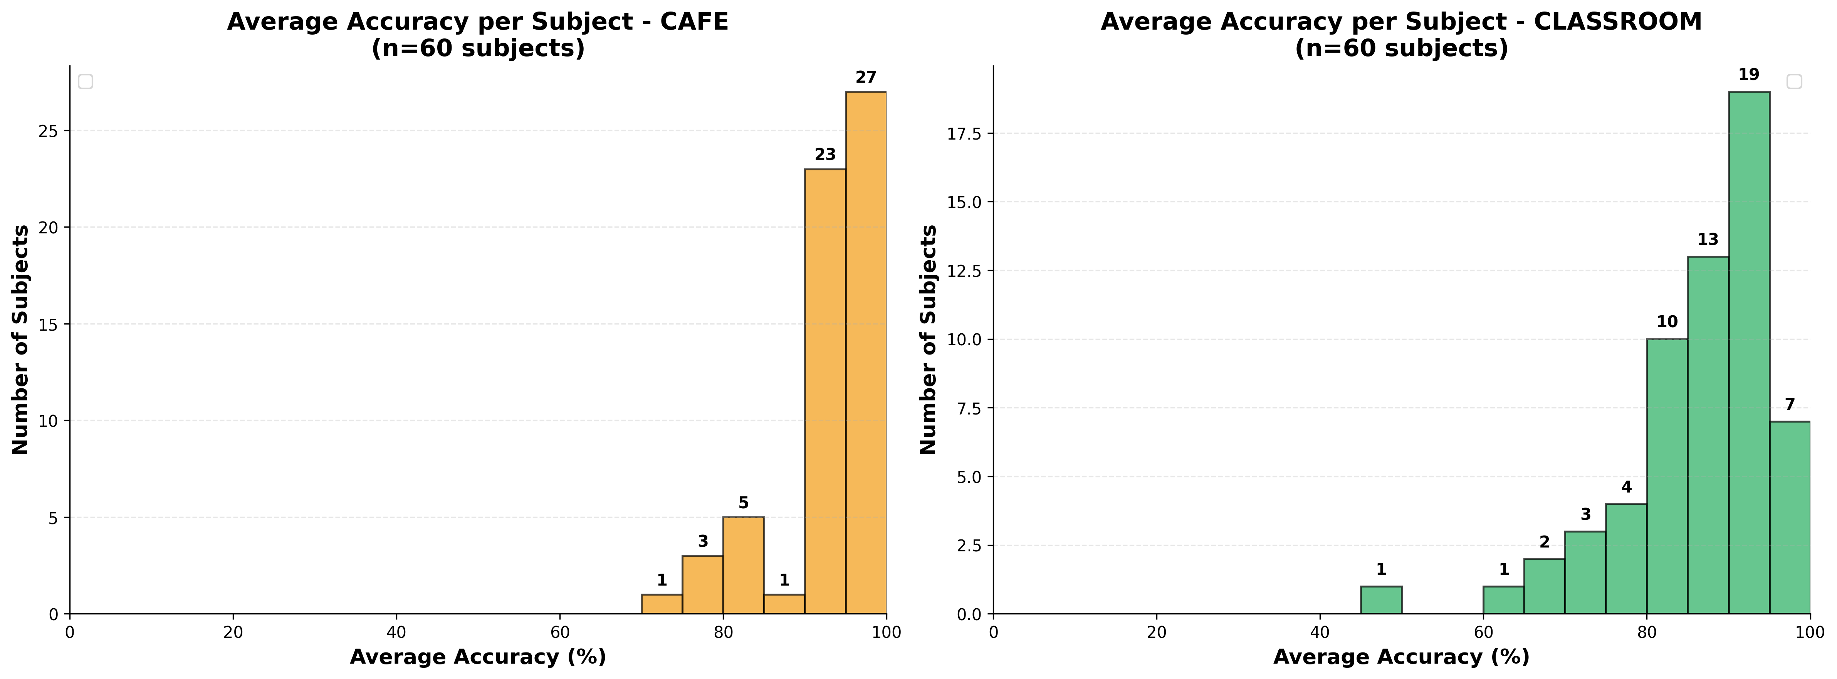

Slide 40
Cafe environment
t-Test: Paired Two Sample for Means
מידע על הסביבה
Category | result
t Stat | 6.72
P(T<=t) two-tail | 0.00000002
t Critical two-tail | 2.001

Slide 41
Cafe environment
Interest-level
מידע על הסביבה
category | Percentage
Mean different | 0.79%
Standard Deviation (SD) | 0.06%
Variance | 0.0015%

Slide 42
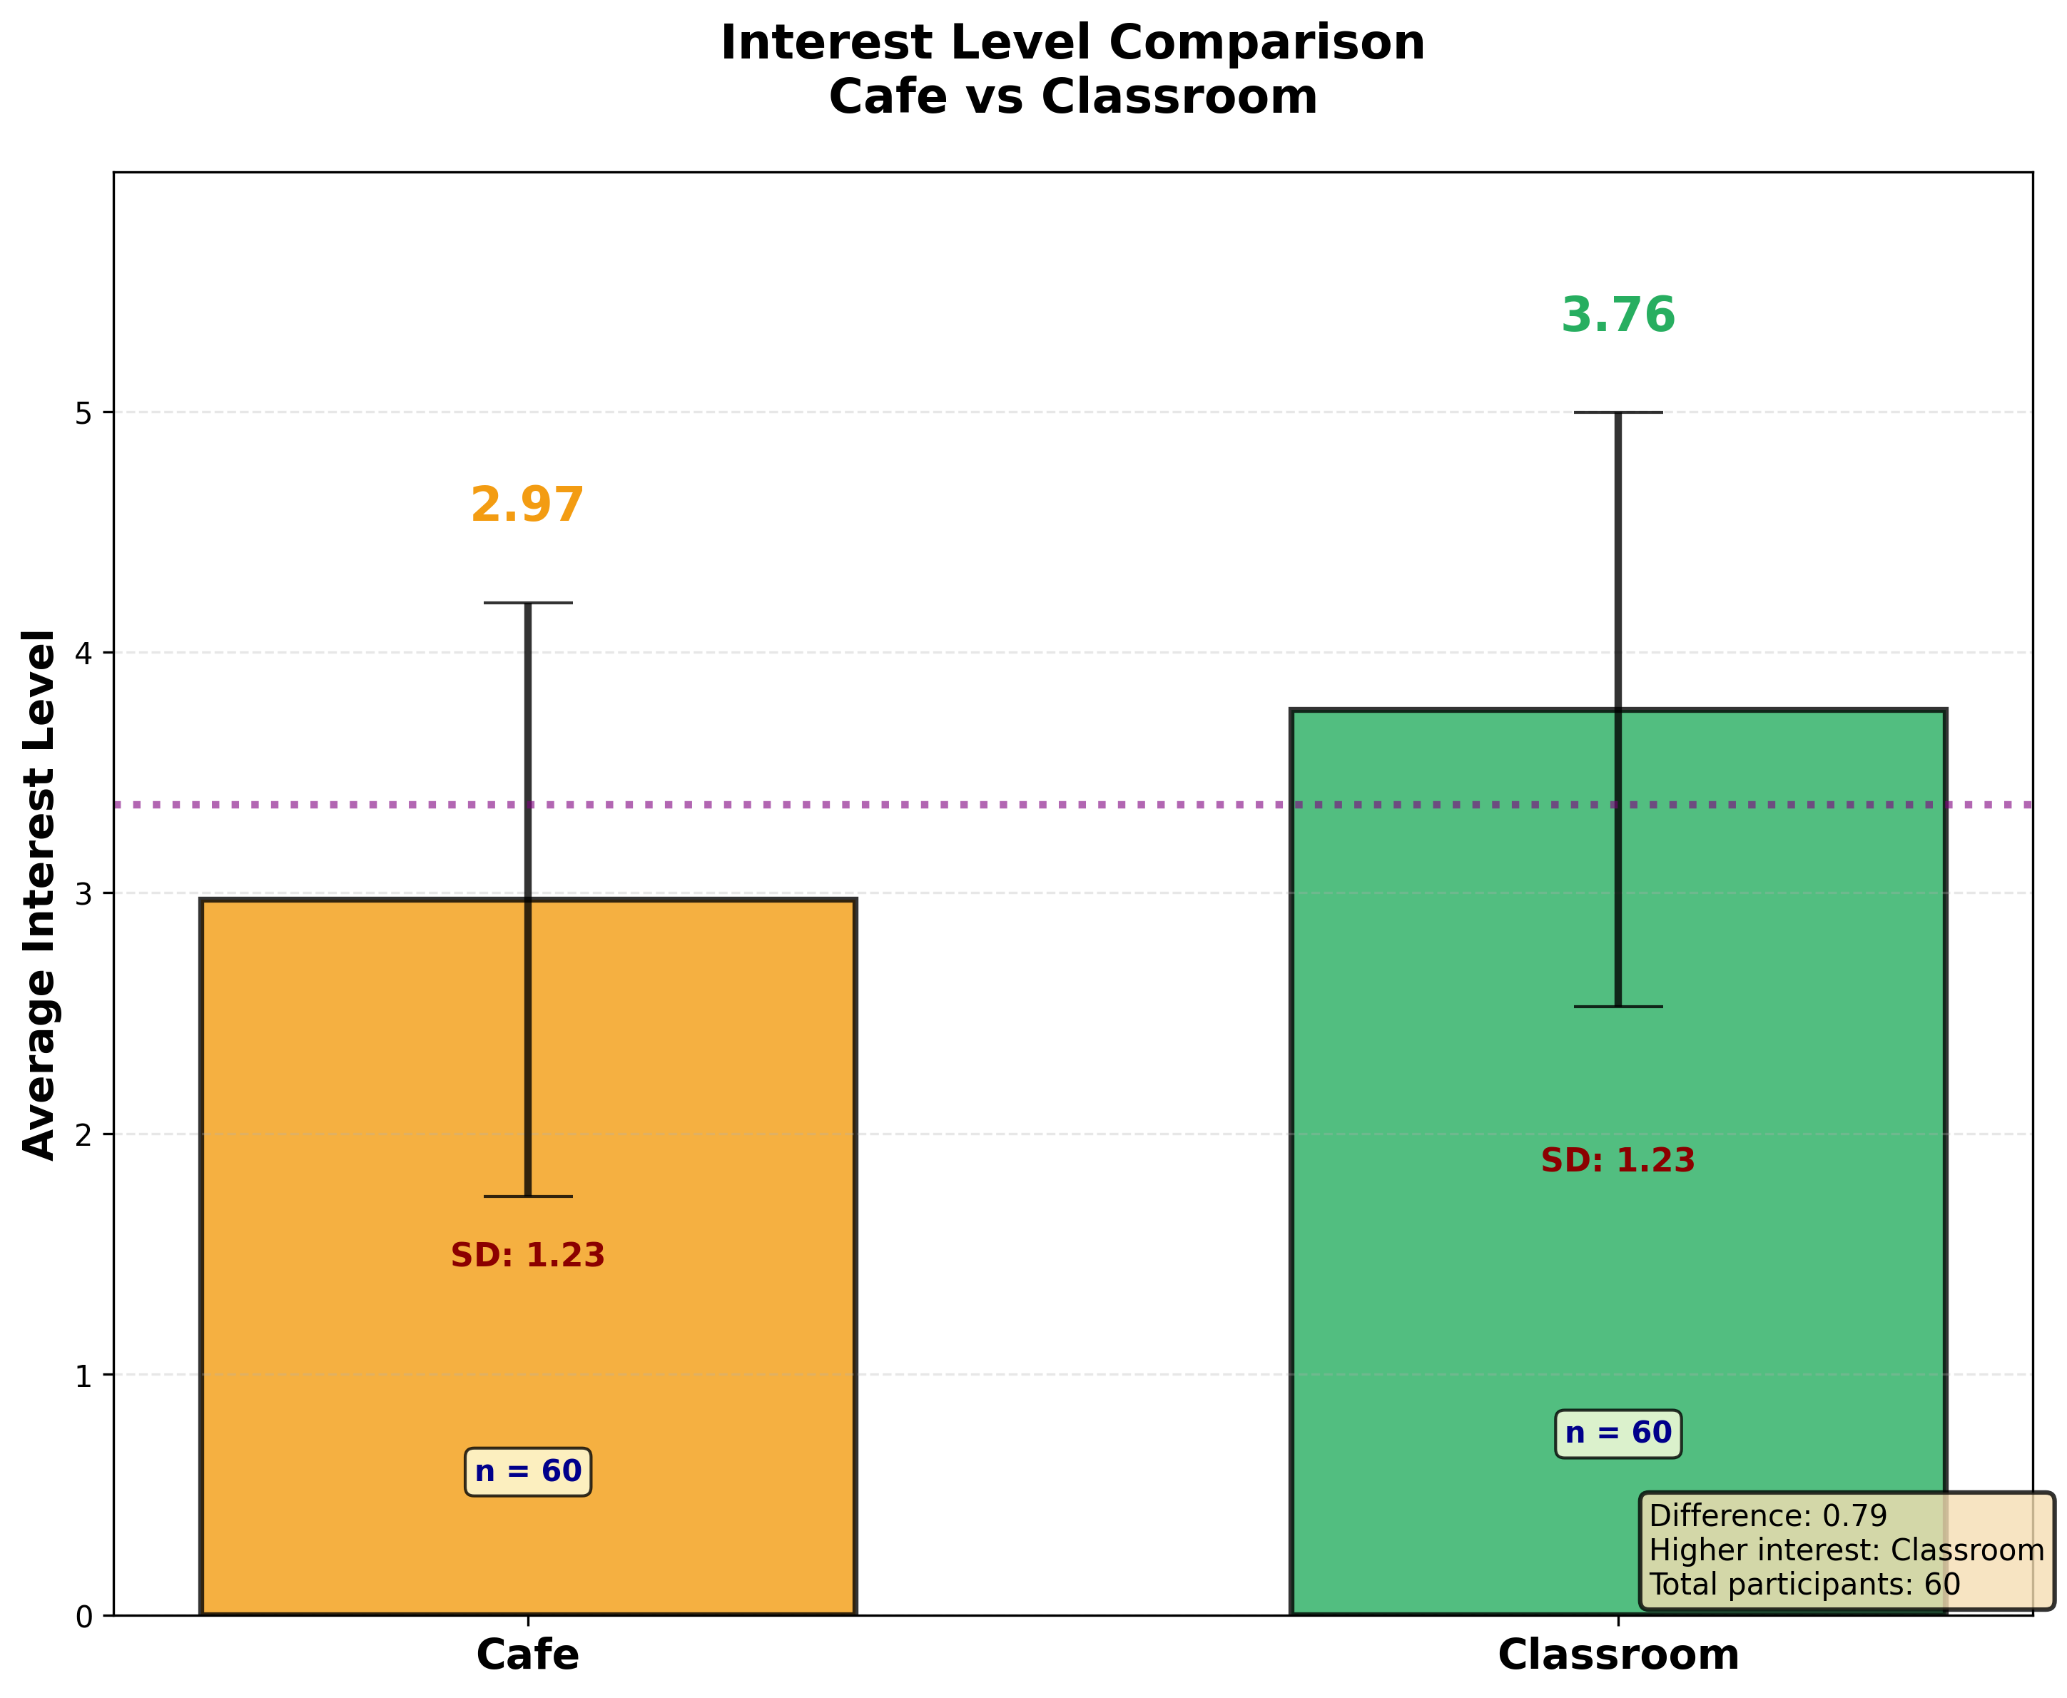

Slide 43
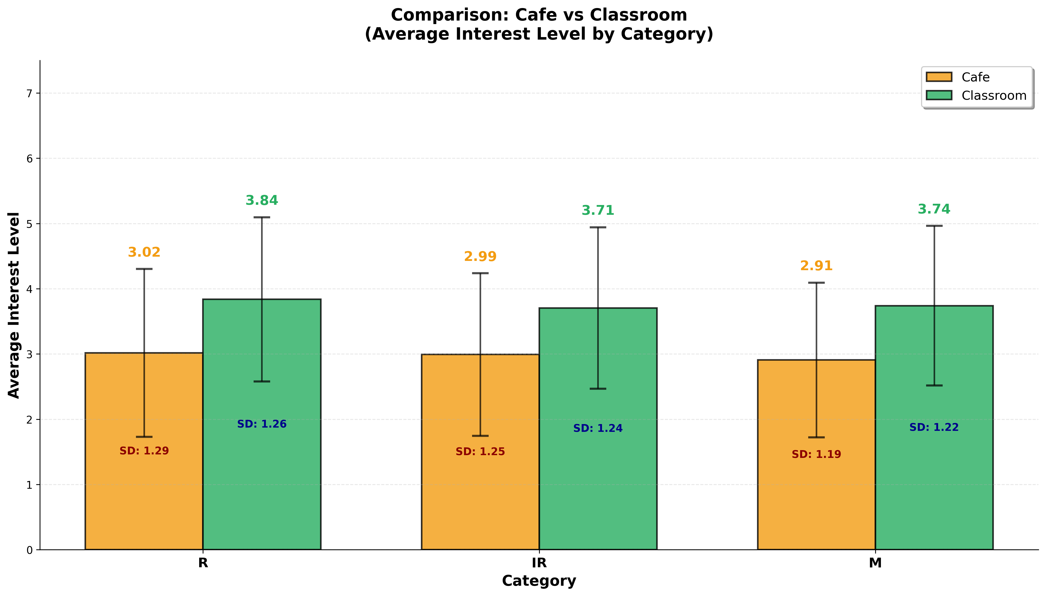

Slide 44
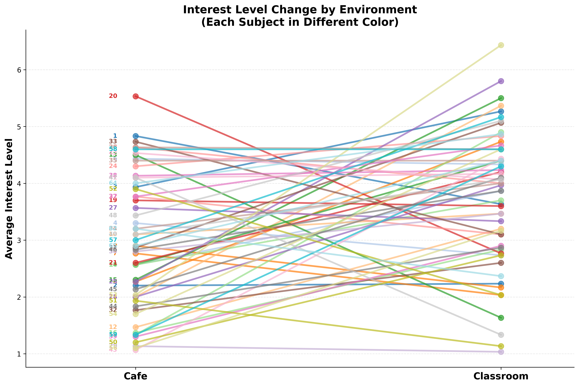

Slide 45
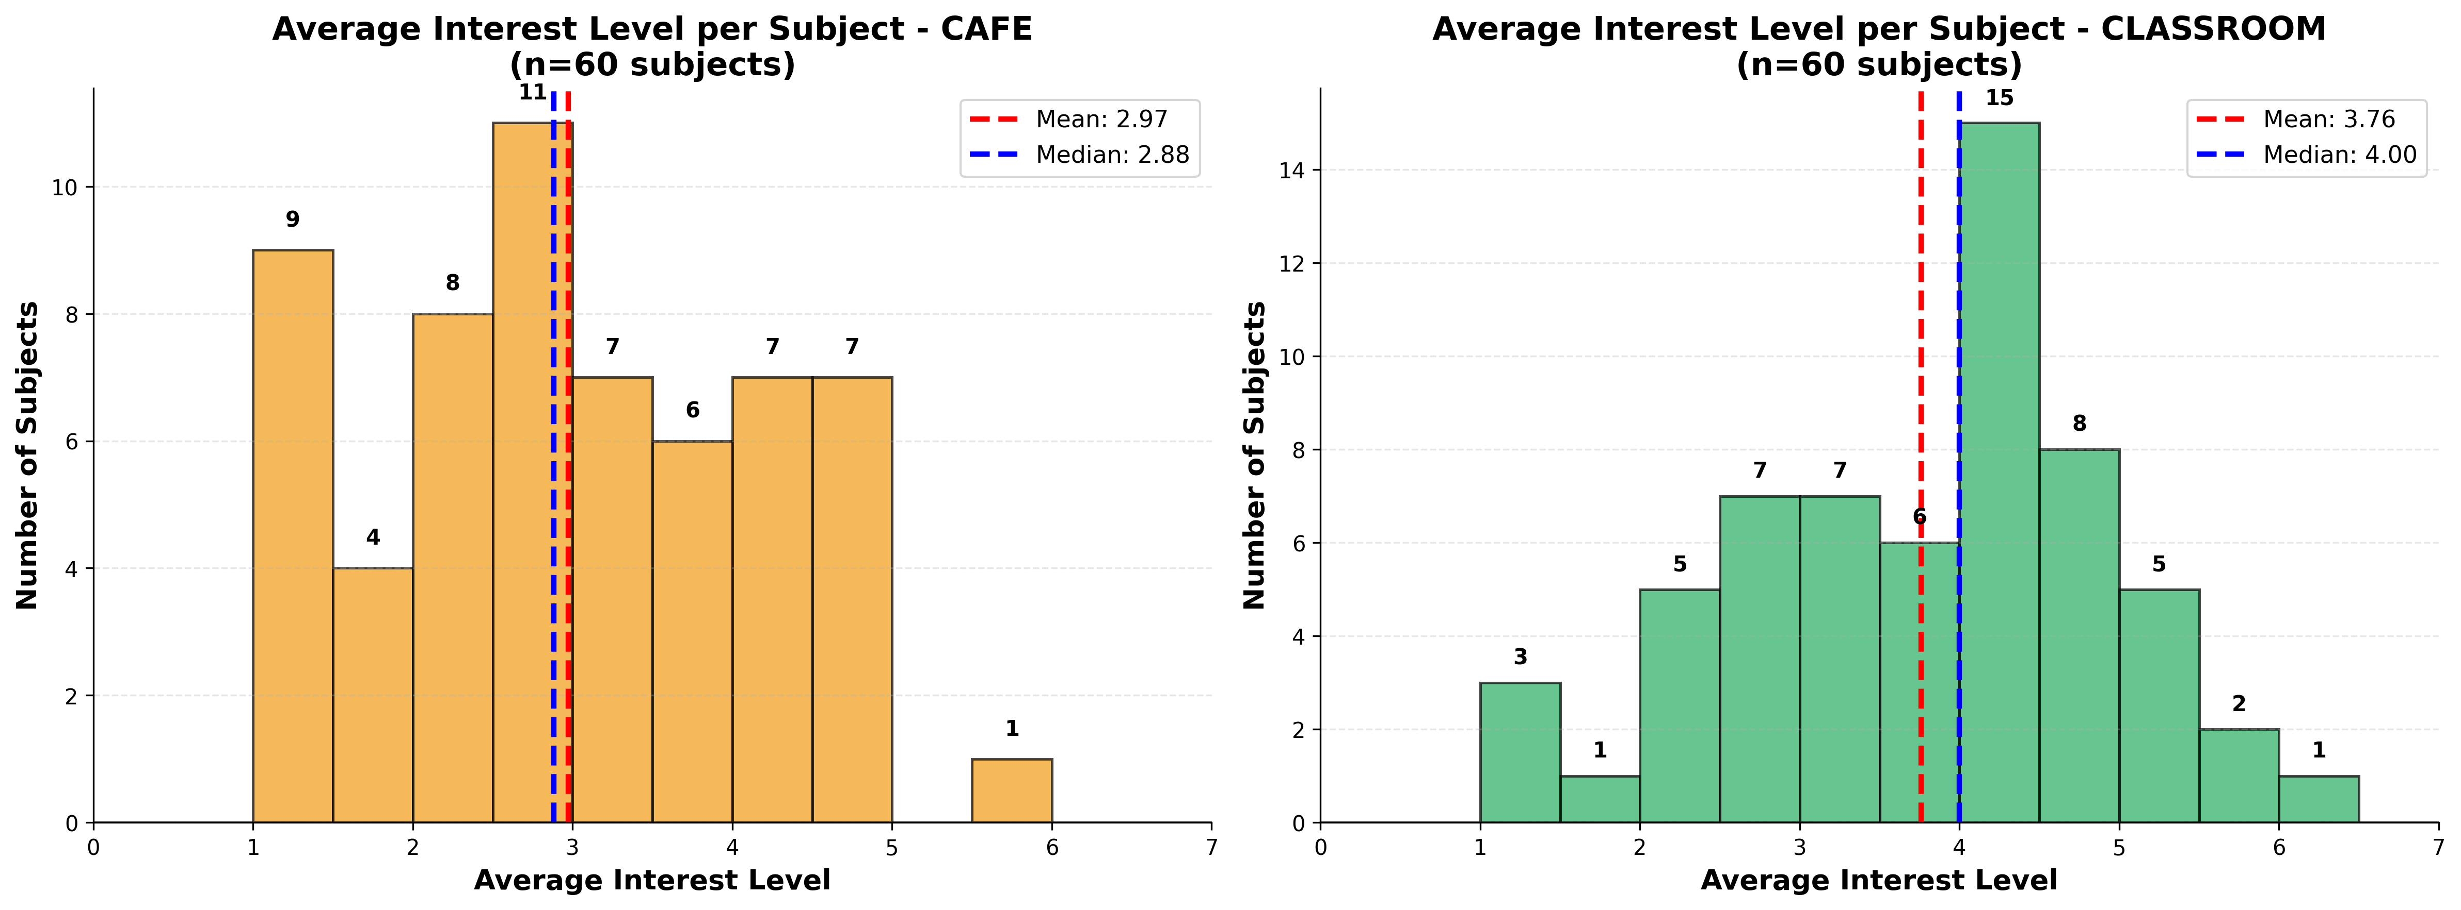

Slide 46
Cafe environment
t-Test: Paired Two Sample for Means
מידע על הסביבה
Category | result
t Stat | 3.717
P(T<=t) two-tail | 0.00045
t Critical two-tail | 2.001

Slide 47
Code for analysis
https://github.com/pelegaboz/first_Data_for_lub

